Slide 1
genetic algorithms in different areas of science
Gordon Chalmers
Department of Computer Science
Complex Carbohydrate Research Science

Slide 2
NP complete or NP hard problems, i.e. are generally exponentially complex problems
Evolutionary algorithms – in particular, genetic algorithms
Approximate hard problems with search space of the order O()
3 different applications; all of these problems are impossible to find solutions with exhaustive searches due to the size of the search spaces
Outline

Slide 3
Uses population of chromosomes, i.e. individuals
Crossover/mutation of the population chromosome information, modeling evolution to maximize/minimize fitness
Evolves population until a ‘good fitness’ is found
I have used GA’s in C++ and in Matlab
Matlab is very good – some restrictions with integer information
Genetic algorithms

Slide 4
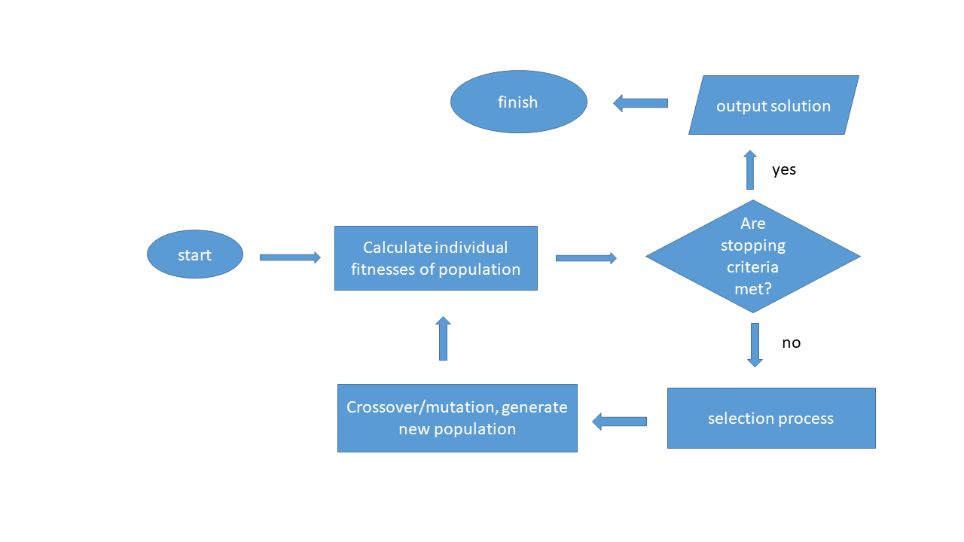
Flow of genetic algorithm
-- Could take many iterations
-- Known to be slow

Slide 5
3 different demonstrations
Real-Time Systems, Sensitivity Analysis
Sparsely Labeled Protein Spectrum Assignment
Maximally Spanning k-tree Problem
These genetic algorithms are very different in comparison.
Only work in PhD dissertation, i.e. genetic algorithms, is discussed.
problems

Slide 6
Sensitivity analysis of scheduling
Mode transition work
Goal : determine minimal task set parameter change to make real-time schedule feasible
In the context of 1) infeasible real-time schedules and 2) mode transition real-time scheduling
PART I - Real-Time Systems

Slide 7
No infeasible tasks for schedulability
Task parameters are execution times, periods, and in our model periods are equal to deadlines
Rate monotonic – priorities are in increasing periods
Each task releases a sequence of jobs at with release time and deadline
TDA equations are well-known and used for schedulability
Complexity - co-NP Hard
Definition of Real-Time System

Slide 8
Priority : which jobs have the resource in priority fashion
Period : release time between jobs
Deadline : max time for a job to complete work
Execution time : time required of resource
Worst case response time : calculated time to completion of a job
TDA : time demand analysis equations to determine schedulability and worst case response times
Infeasible : schedule has at least one task that misses its deadline,
e.g. if utilization is greater than 100%
Terms in the Scheduling

Slide 9
Schedule is infeasible
Task set parameters are changed to make the schedule feasible
3 different approaches are known
Genetic algorithm is a new approach
Sensitivity Analysis

Slide 10
- task scalings, periods, worst case response time
- Scaling is that of periods to make task set feasible; increasing periods lowers utilizatio0n and in this scheduling less than 69% is schedulable
- Fitness
- Constraint is , TDA equation
Genetic algorithm treats the entire task set as a whole
Previous techniques are task-by-task
Crossover is single-point,
Chromosome and fitness

Slide 11
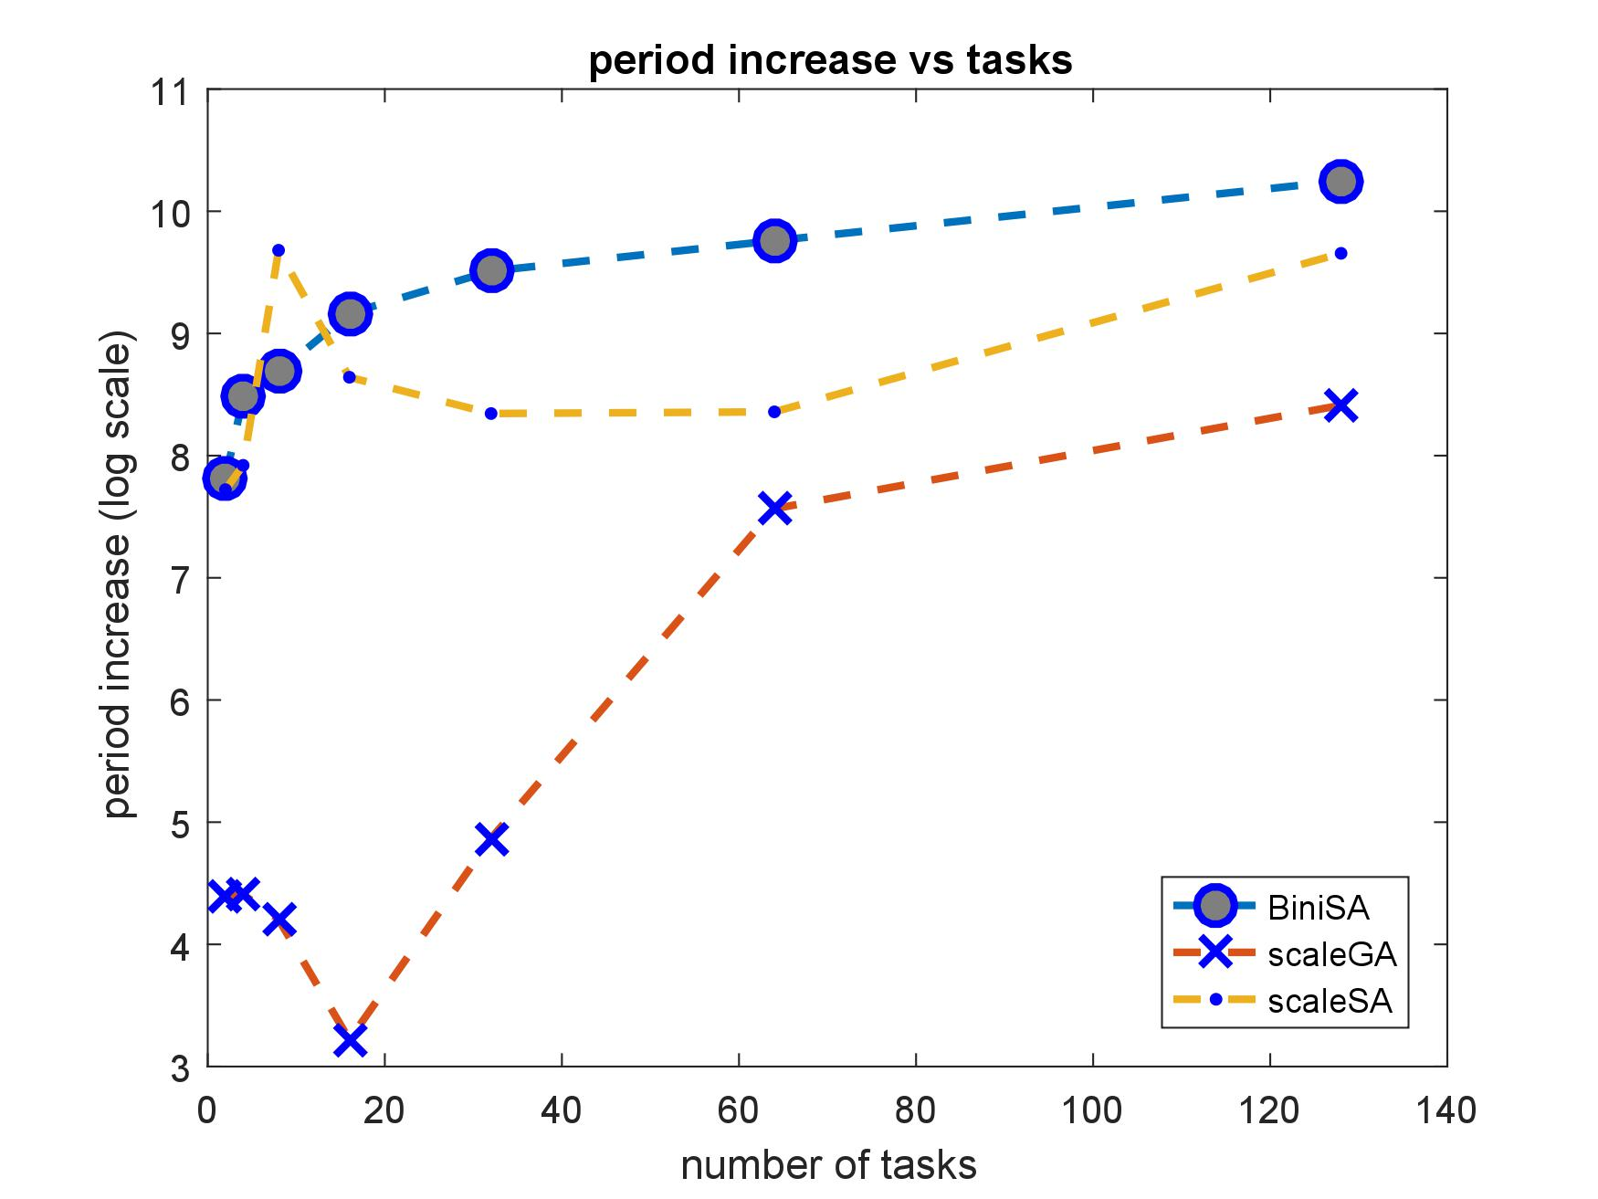
3 types of sensitivity
scaleGA
scaleSA
BiniSA
initial utilization 100%
Fitness comparison

Slide 12
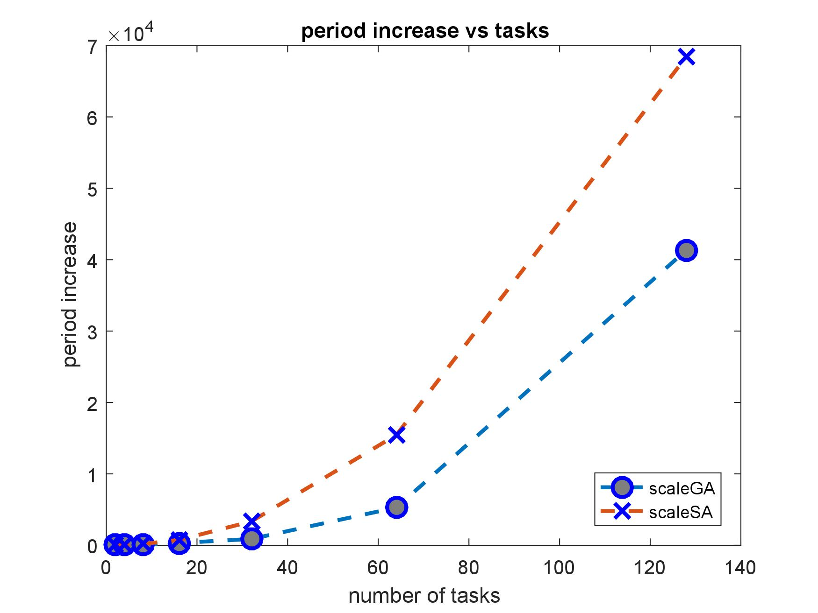
initial utilization 150%
3rd algorithm works for 100%
Fitness comparison

Slide 13
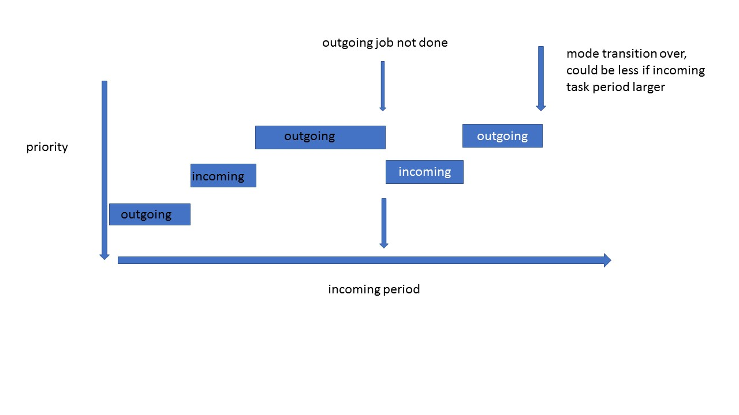
3 tasks, 1 incoming, 2 outgoing
3
2
1
increase incoming task periods, not all tasks
less interference between task 1 and 2
mode transition time decreases
Mode transitions, example

Slide 14
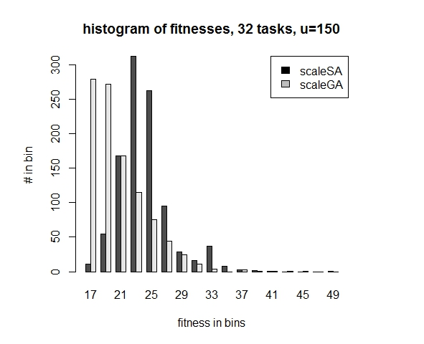
initial utilization 150%
genetic algorithm has lower fitness, i.e. higher utilization
Mode transition fitnesses

Slide 15
Genetic algorithm was successfully used in improving sensitivity analysis of schedules and mode transitions
Outperformed previous algorithms
Unlike previous techniques, the genetic algorithm gives many possible solutions with better fitness
Conclusions – Real time systems

Slide 16
Assign_SLP_MD is used to sparsely label proteins, and possibly carbohydrates.
Uses experimental spectral data, residual dipolar couplings, and chemical shifts to compare with molecular dynamics modeling calculation to find best match spectral peak to residue.
Related - requires accurate calculation of noe’s from MD trajectories for proteins, not discussed in detail. approximation is not appropriate for large molecules
Several software packages available at the Prestegard site or at the carbohydrate Glycam Woods site
Part II – Spectral assignment using genetic algorithm

Slide 17
Sparsely labeled spectral assignment can be difficult for certain types of proteins, and the genetic algorithm is used.
N spectral peaks to protein structure without repetition
Complexity is N!
The program has been tested with ST6Gal1, 5 small proteins and a protein HtpG with 50 residues
complexity

Slide 18
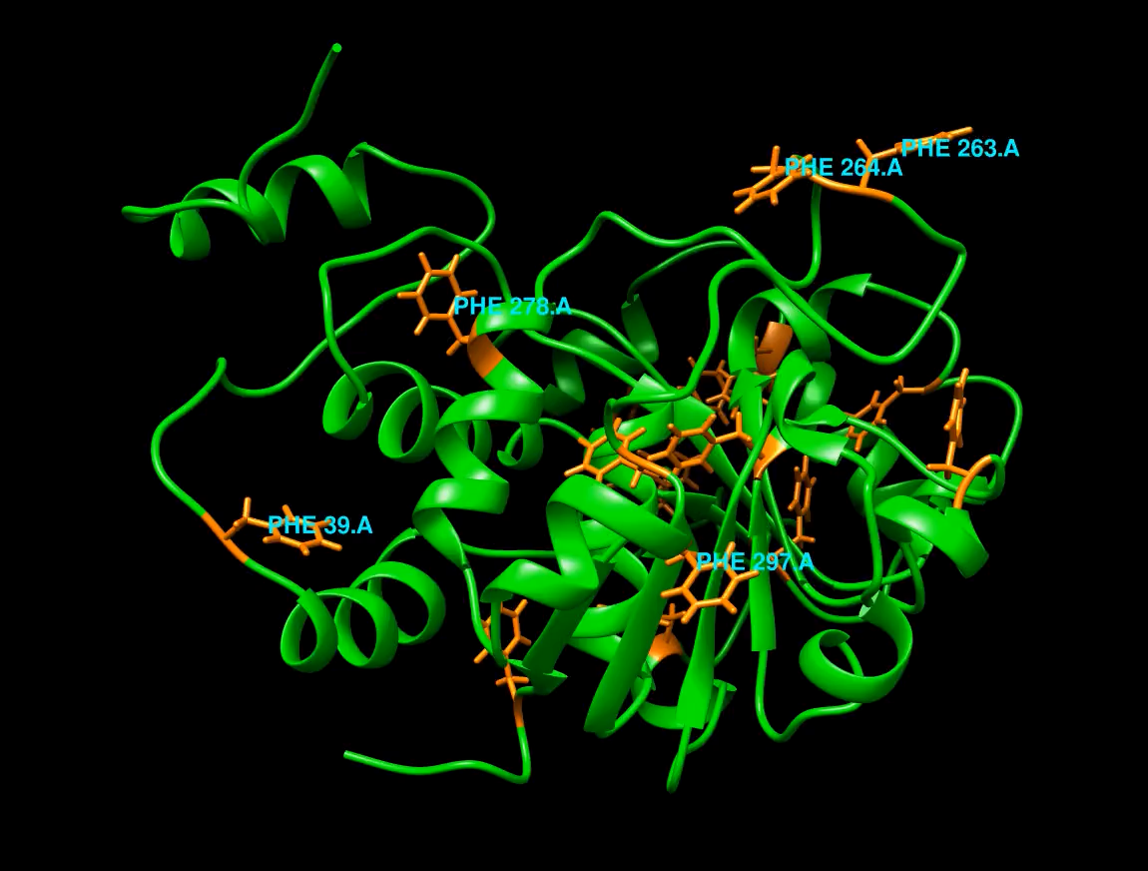
ST6Gal1

Slide 19
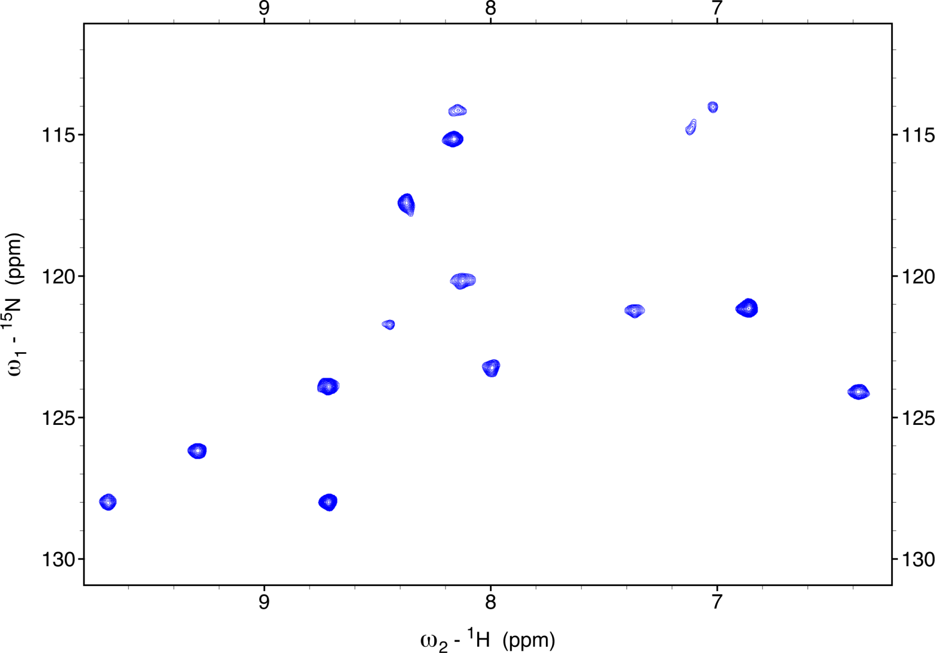
HSQC of ¹⁵N-Phenylalanine Labeled ST6Gal1
10
15
9
17
8
14
16
6
7
13
12
5
11
4
2
3
1

Slide 21
Trajectories and the complete relaxation rate matrix formalism is necessary to calculate NOE’s if:
1) the protein is large, e.g. >20 kDa
2) conformational changes or if there are indirect noe’s.
3) Spin diffusion is important.
In both cases previous techniques would fail.
MD2NOE_Protein is package to calculate, not discussed, but the output is an input to Assign_SLP_MD.
Necessary Background - Noe calculation programs

Slide 22
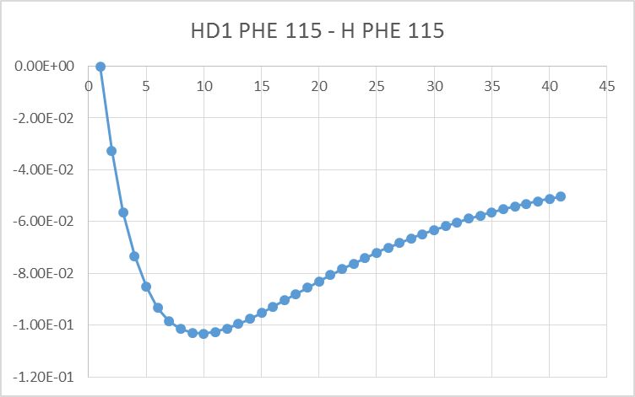
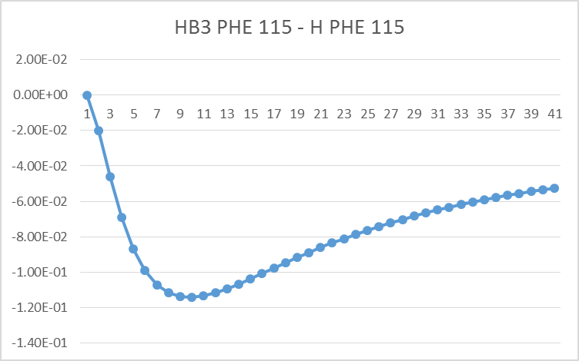
Build-up Results from trajectory
Indirect noe
At 40 ms I_{HD1}/I_{HB3} = 0.9;
not 4.7 from previous techniques
Even at 10 ms I_{HD1}/I_{HB3} is only 1.2

Slide 23
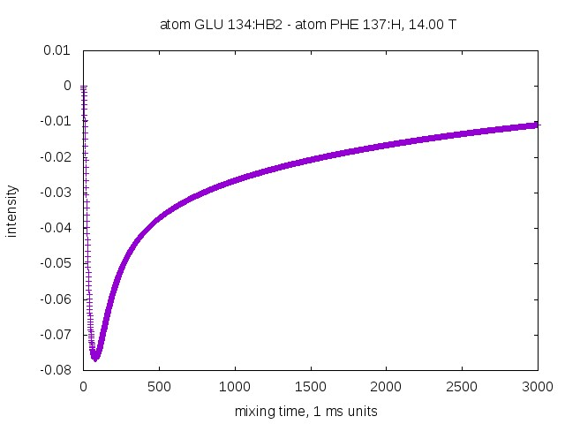
: negative
Bad signal
Good linear model
This is the case for proteins.
Can be used to maximize signal to noise. Especially if many spin pair measurements are to be maximized.
Measurement should be taken at this mixing time for best SNR
Good signal
Needs complete calculation
Advantages of Trajectory Noe curve

Slide 24
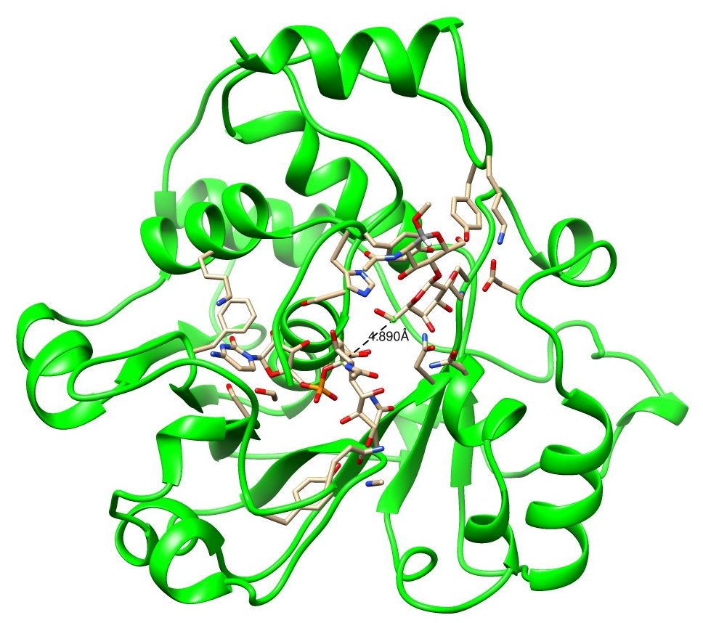
Include all spin pairs with inter-distance < e.g. 5 A in complete relaxation rate matrix.
All spin pairs are within this this
sphere of radius R. Larger sphere, more spin pairs, more accuracy. More calculation.
How do we do this – ‘Sphere approximation’. Quasi-local, nonlinear

Slide 25
Noe’s at mixing time
Rdc’s (residual dipolar couplings)
Noe spectral strips (1-d spectra for each residue)
Chemical shifts
Multiple media can be used (e.g. phage, peg for alignment)
Goal is to compare experimental and modeled data of different types to find best fit – finding which measurement goes to which part of the protein
All of these use measurements and predictions from entire trajectory
Assign_SLP_MD genetic algorithm

Slide 26
Assign_SLP_MD Assignment flow
Order parameter files, predicted chsmical shift files, noe file
NOE strips
RDC’s, chemical shifts, weights
GUI is in progress
Make input excel workbook
Experimental measurements
statistics figure of assignment
Run genetic algorithm
Text file with possible solutions
Run output analysis program
Optional - Run statistics program
Confidence level

Slide 27
PD 113 – CP 8
Appears best fit
0.6604
0.5359
0.5966
0.3623
---------
0.5916
0.5028
0.5862
0.3453
0.3221
0.7212
0.6050
0.6018
0.6920
0.3094
0.5312
Example NOE strips and comparison with calculation

Slide 28
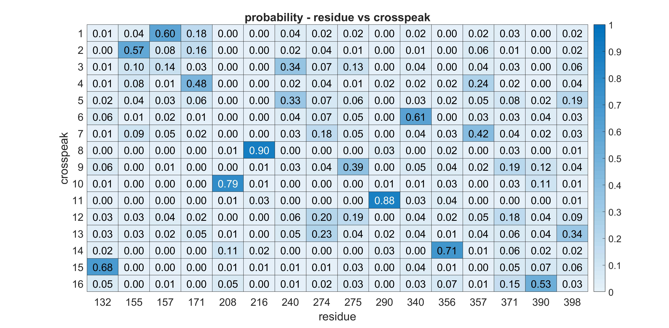
Anything over .50 is 90% confidence
.50 changes depending on predictions, data, protein – not described
Statistics part of package. Statistical Weights are used in estimating likeliness of correctness.

Slide 29
rST6Gal1
16 PHE peaks
Mutagenesis was used as a check in 4 of the residues Assign_SLP_MD got all correct with high Probability

Slide 30
Proteins have conformations
Genetic algorithm can be used to identify and calculate populations using trajectories
Still not good enough sampling
States of proteins – additional use of Assign_SLP is population determination

Slide 31
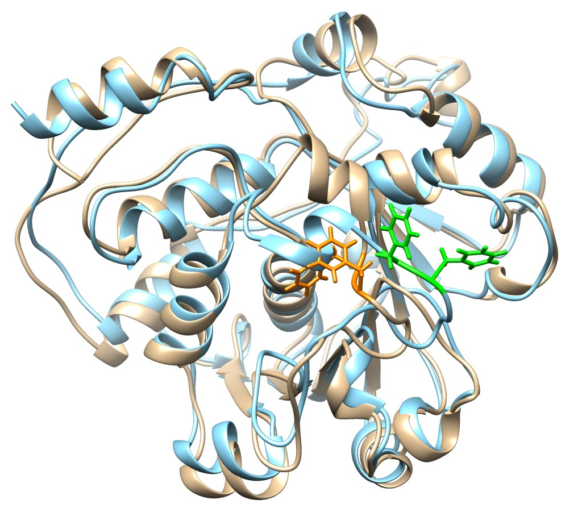
rST6Gal1 1μs MD Final Structure
Note that Phe 264 in the final structure (orange) is buried
Transition between 2 distinct states, about residues 263/264
Genetic algorithm can be used to identify population
3 different trajectories were used finding states and comparing assignments

Slide 32
Assign_SLP_MD, MD2NOE_Protein
Has been used in assigning sparsely labeled rST6GAl1, 5 smaller proteins, HtpG, and LAR (Qi Gao, …)
Software will be further developed by others in the 4 years due to an NIH R01 grant
Currently simplifying software and making a GUI
Assign_SLP can potentially be used with carbohydrates; different chemical shift prediction software has to be used
conclusion

Slide 33
Maximally spanning k-trees are useful in different areas, such as RNA structure prediction, information theory, neural networks, and is also an interesting NP-Hard problem.
Professor Cai has shown how the approximate solution can be used in RNA structure calculations
Part III – maximally spanning backbone k-tree problem

Slide 34
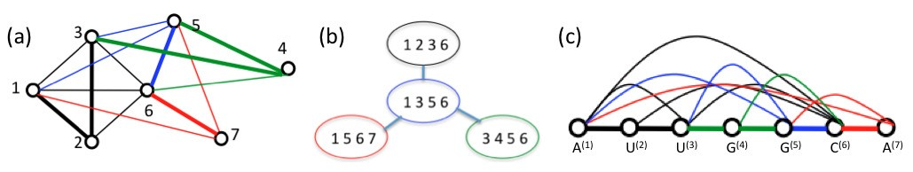
Particular order of (k+1)-cliques
Cover the graph with these special types of (k+1)-cliques
There are restrictions in the backbone case.
Inputs - set of nodes and edges with edge weights
Fig. 3. (a) 3-tree of 7 vertices by Definition 1, with the order of forming four 4-cliques: from clique {1,2,3,6} (black edges), vertex 5 and blue edges added, then vertex 7 and red edges added, and finally vertex 4 and green edges added. (b) Illustration of the graph of (a) with a tree-topology connecting the four 4-cliques.
Formulation
Each edge has a weight.
Fitness maximized is sum of edge weights.

Slide 35
Definition 1. (Patil, 1986) Let integer k ≥ 1. The class of k-trees are graphs defined by the following inductive steps:
A k-tree of k + 1 vertices is a clique of k + 1 vertices;
A k-tree of n vertices, for n > k+1, is a graph consisting of a k-tree G of n−1 vertices and a vertex v, which does not occur in G, such that v forms a (k + 1)-clique with some k-clique already in G
Also different types, e.g. backbone, partially backbone, directed/undirected, …
Genetic algorithm can deal with all types, unlike the dynamic program
N is number of nodes
Formulation

Slide 36
Chromosome is complicated
What is different about this genetic algorithm is that it is hard to have only local changes in the chromosomes
Changing one or more genes will change the entire set of k+1 cliques that cover the N nodes. The k-tree construction is sequential in the node order
Chromosome change is not local, a difficulty
Genetic algorithm

Slide 37
The test is how the genetic algorithm compares with the dynamic program that Professor Cai and his students have.
There are approximations in the dynamic program and only a single solution can be found
The genetic algorithm is performing better in fitness than this dynamic program. It also generates many solutions with better fitness.
Professor cai and students have a dynamic program

Slide 38
The genetic algorithm fitnesses are larger by several percent than the dynamic program.
The parameters of n=100, k=1 to 20 were tested and the algorithm was better in fitness and number of solutions.
Many solutions are also given, over 1000’s in general.
This improvement and multiple solutions could improve the accuracy of the RNA structure calculations.
performance

Slide 39
1st
2nd
3rd
The chromosome is broken into 3 segments.
1st segment: ordered set of the numbers from 1 to N with no repetition; this is the node order in the clique construction
2nd segment: set of numbers which say what previous clique is to make current clique
3rd segment: set of numbers which say which node in previous clique is changed with current node
Important – the population is initialized with the output chromosome of the dynamic program
a 1-d array
Chromosome and population

Slide 40
first part 36 68 43 35 55 33 52 51 53 54 ...
second part 0 1 2 3 4 5 5 7 8 9 ...
third part 0 3 3 3 2 2 2 1 1 2 ...
Example Chromosome – see dissertation for details

Slide 41
Node numbers, fitness
39 40 41 42 36 5.6603
36 39 40 42 68 2.6396
36 39 42 68 43 2.7885
36 39 43 68 35 2.4445
35 36 43 68 55 2.7784
35 43 55 68 33 3.1212
…
Fitness is sum of edge weights of k-tree cover of the nodes
Edge weight matrix w(i,j), for nodes i and j
Example k=3 tree, 100 nodes

Slide 42
u u u u x x x x u u u u - the x’s are sorted or flipped in order
Crossover
1) Set of nodes in the order of the chromosome is sorted, in first part
2) Set of nodes in the order of the chromosome is flipped in order
Mutation
1) segment in 2 different chromosomes are interchanged
2) node insertion point of a k+1 clique is randomly changed
u u u u x x x x u u u u
u u u u x x x x u u u u
the x’s are interchanged in the 2 chromosomes
Crossover, mutation

Slide 43
k-tree 3 4 5 …
dynamic fitness 192.82 254.31 313.52 …
genetic fitness 193.74 255.48 315.36 ...
no. of solutions 188 1353 4477 …
Fitness not much better, but many solutions – good for applications
Example comparison from the genetic algorithm

Slide 44
Genetic algorithm was used to approximate the maximally spanning backbone tree problem
Outperformed earlier algorithm using a dynamic program
An important reason for this performance is the initialization of the population and the elite fraction of 5%
Conclusions – part iii

Slide 45
Collaborators:
I. Professor Funk
II. Professors Prestegard, Woods, Moreman
Alex Eletsky, Qi Gao, Rob Williams, Kari Pederson, Laura Morris, John Glushka
III. Professor Funk and Cai, Liang Ding
Not all PhD work is included in this presentation
collaborators

